Slide 1
VMignite.com presents: VM Troubleshooting Dashboard
Part of a Maximize IT series by http://www.vmignite.com
By: Lan Nguyen

Slide 2
Disclaimer
Everything in these slides does not represent VMware, but my own personal opinion

Slide 3
Use Case: You get a Support Ticket saying my VM is slow. App owner is requesting more CPU and Memory Resources
Everyone assumes it is always a VMware problem
Most of the time VMware Engineers are wasting their time proving it is not their problem
Troubleshooting is taking days to figure out and we still can’t figure out what the root cause is
As a result we give them more resources and still the problem is not solved!
My VM is slow, I need more CPU and Memory again

Slide 4
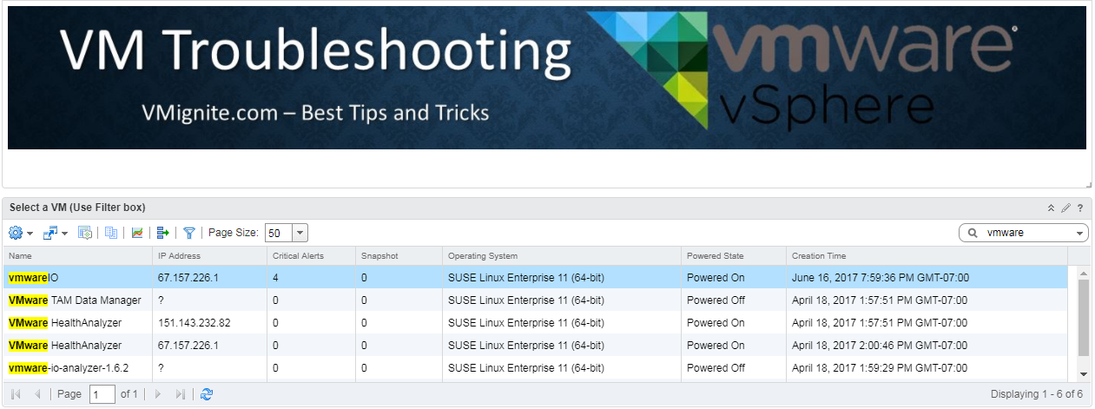
Type in the name of the VM you want to troubleshoot

Slide 5
Notice how there are 4 Critical Alerts

Slide 6
Select your VM, to troubleshoot it

Slide 7
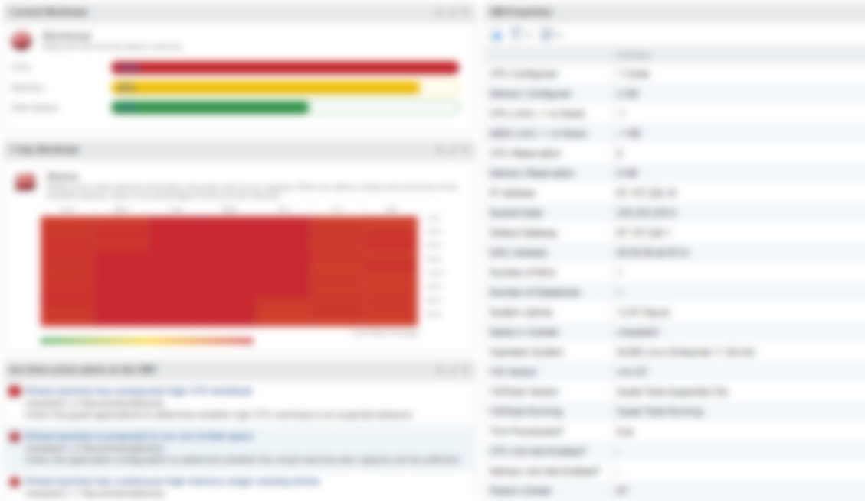
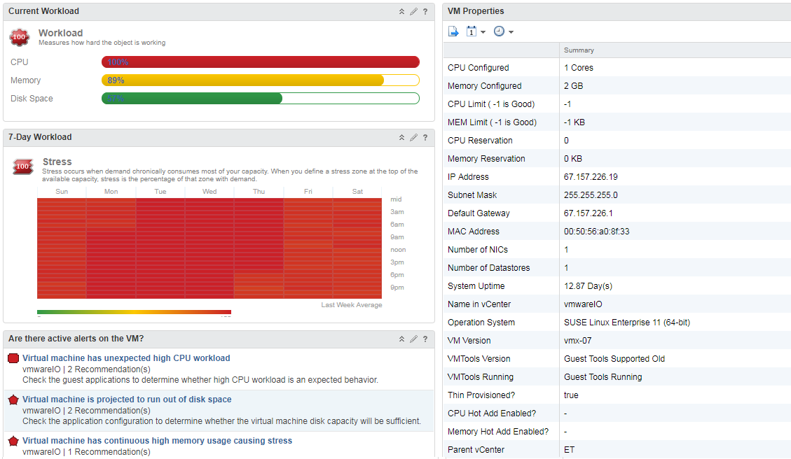

Slide 8
Looks like CPU, and Memory is High!!
Question now is how long has this been happening? When did it first start? What is causing it?

Slide 9
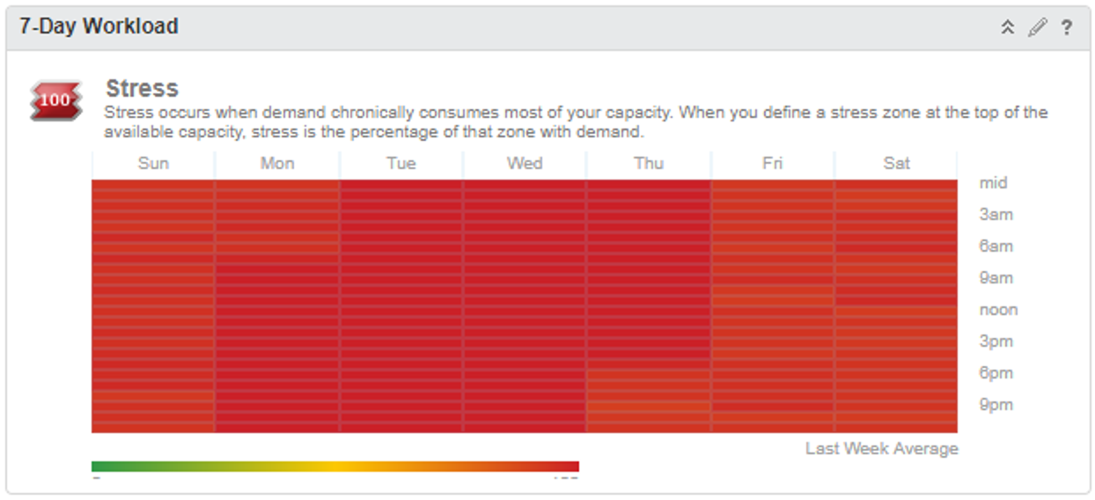
Looks like the VM is working hard everyday and every hour

Slide 10
Alerts verifies that there is a history of high CPU and Memory utilization

Slide 11
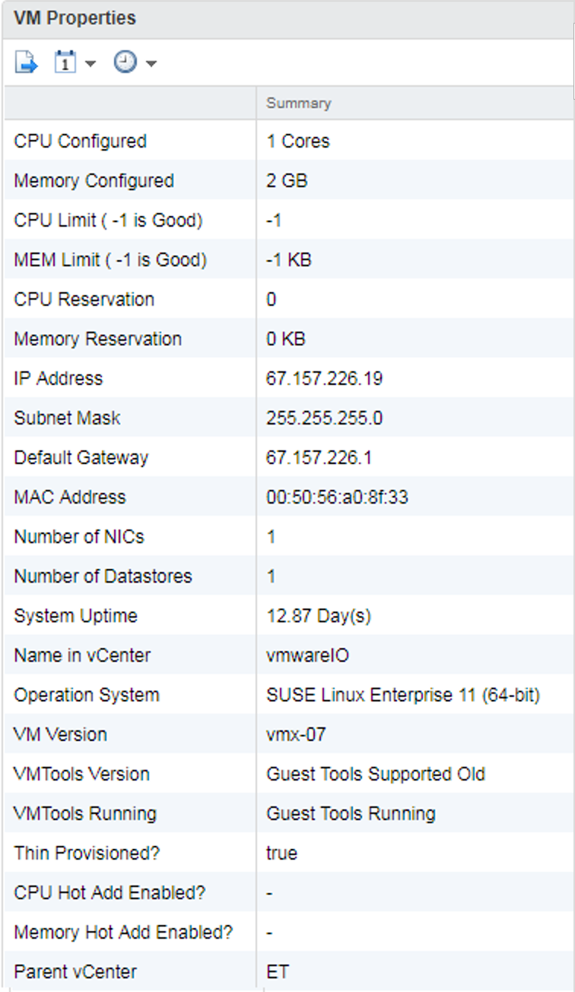
There are no Limits, therefore the VM configuration may not be the problem.

Slide 12
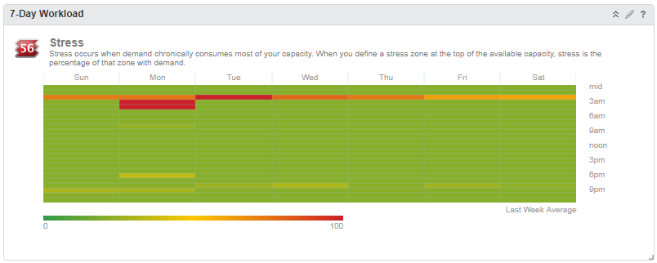
Sample of Stressed caused by backup jobs at 2am at night

Slide 13
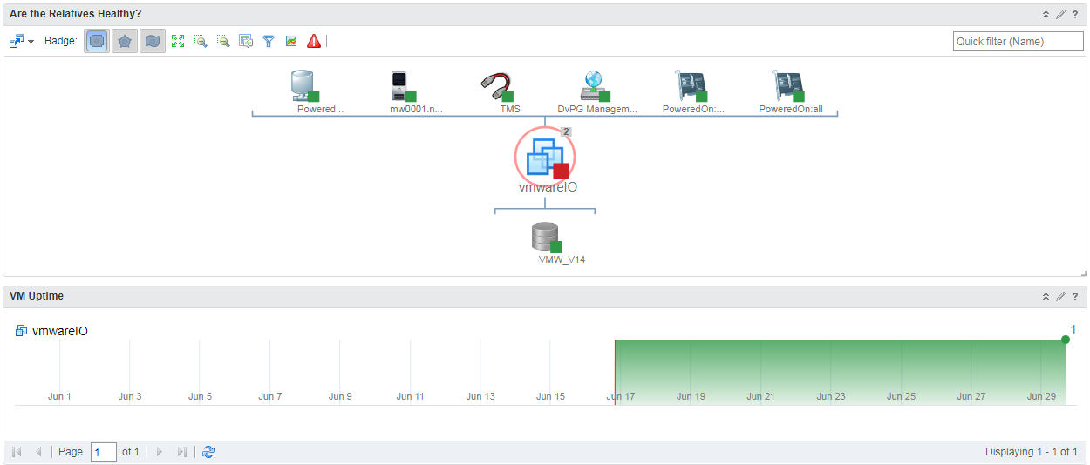

Slide 14
Host Looks healthy
Datastore Looks healthy as well

Slide 15
There is a Resource Pool, could this be constraining resources?
Check vCenter to find out if there are limits set on the resource pool

Slide 16
Looks like the VM has been rebooted a few times

Slide 17
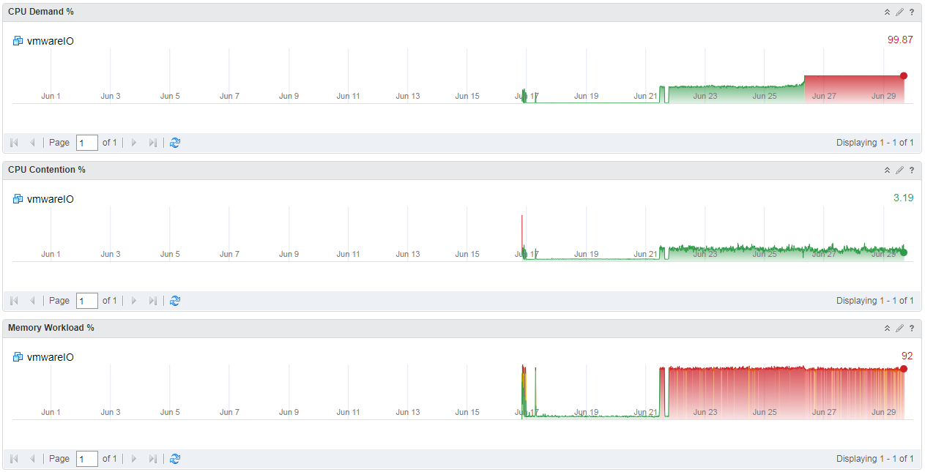

Slide 18
CPU has been gradually increasing. Signs of increased demand

Slide 19
Memory just spiked up all of a sudden. What happened here?
Was an application installed or a major configuration change occurred that caused the major sudden spike?

Slide 20
Use your mouse to zoom in on the graph.
We can see that it spiked exactly on Monday, at 8:22am. Now let’s go ask the app owner what happened at this time

Slide 21
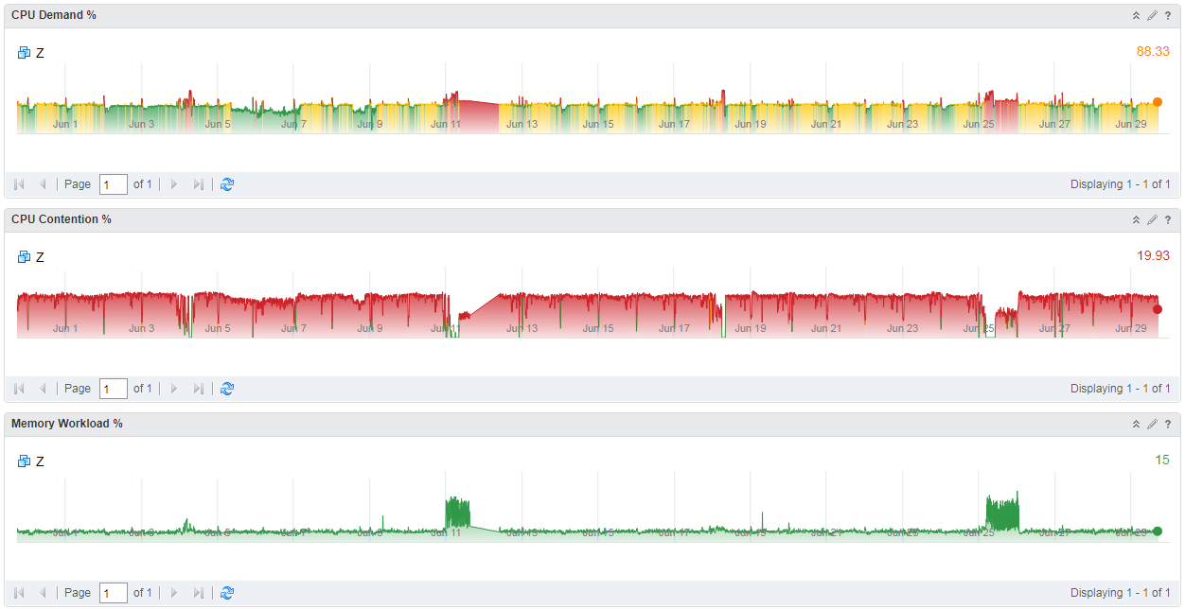
Another sample of a VM that has consistent high CPU utilization and really high CPU contention

Slide 22
What did we learn?
Finding the Root cause is the first step in troubleshooting. The VM Troubleshooting dashboard helped us quickly identify the problem
Once we found out what the problem was, we needed to see if we can eliminate the VM configuration, the parent host, parent Datastore, and resource pool as the cause of the problem
Next we needed to see when the problem started and how long has it been happening. The historic trends will tell us if it is an application problem or the VM just needs more resources
Visit http://www.vmignite.com for the latest in the Maximize IT series

